Slide 1
Developing Forecasting models for predicting Product Demand of a Manufacturing Company
Pallavi Sharma
Gibran Haque

Slide 2
Problem Description
With companies having a global footprint, knowing the demand forecast for the products in advance leads to decreased lead time and increased efficiency.
The previously present demand data helps us forecast the demand of the following months.
Thus, studying the seasonality and trends of the demand data present, forecasting model can be developed and trained to forecast the future demand.

Slide 3
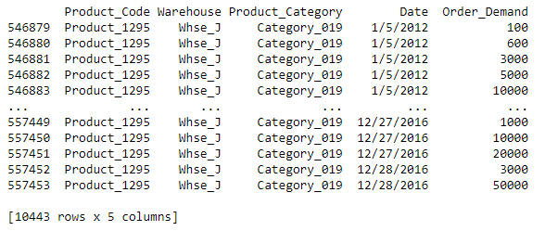
Demand Data for a Manufacturing Company

Slide 4
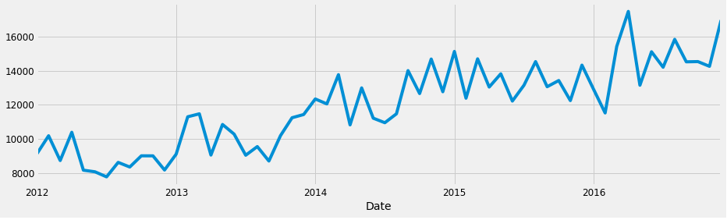
Average demand in each month of the four years for a particular product
The mean average demand data for four years- 2012 to 2016 has been plotted, showing a trend as well as seasonality pattern in the demand.
It shows a growth in demand over the years, with a generally low demand in the initial months of the year and higher demand towards the end of year.
To deconstruct the time-series into its systematic and non-systematic components, the time-series decomposition is done.

Slide 5
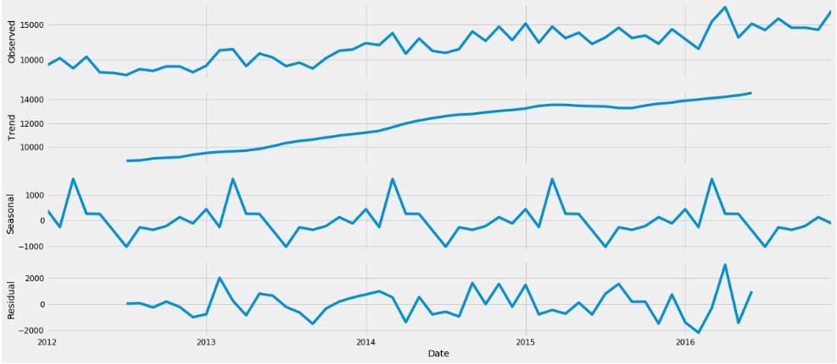
Data Analysis using Time-series decomposition
Time-series components—
Level:- average values in the series
Trend:- increasing or decreasing value in the series Systematic Components
Sesonality:- repeating short term cycle in the series
Noise:- random variation in series Non-Systematic Component

Slide 6
Models used for Time-Series Analysis
Simple Exponential Smoothing
Holt’s Method using Static Seasonality Indices
Holt-Winter’s Seasonal Method
Seasonal Autoregressive Integrated Moving Average (SARIMA)

Slide 7

Simple Exponential Smoothing Method
For given Demands D1, D2, …, Dn, Forecast for period (n+1) is given by :-
α is between 0 and 1, known as the Smoothing Constant.
Most recent demand is given the highest weight α and the weights are decreased by a factor (1 - α) as the data gets older.

Slide 8
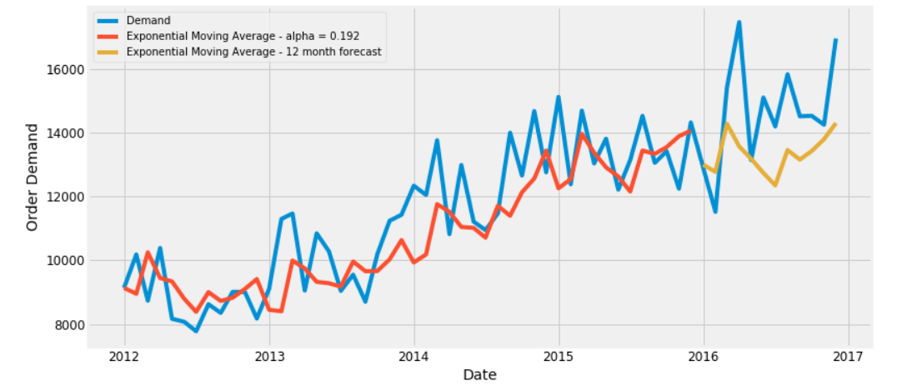
Validating Exponential Smoothing Forecasted Data
The mean square error is 3587569.64
The Root Mean Squared Error is 1894.09
The Mean Absolute Percentage error is 10.09%

Slide 9
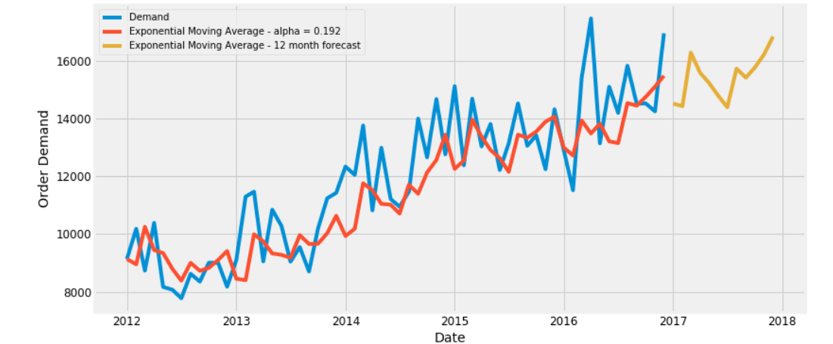
Visualizing Future Forecasts using Simple Exponential Smoothing Model

Slide 10
Holt’s Method using Static Seasonality Indices
Holt’s model computes forecast by estimating both level (L_{t}) and trend factor (T_{t}). It adjusts both the factors by using exponential smoothing.
Forecast F_{t + 1} for given demand D_{t} and estimates of level and trend factors is given by
F_{t+1} = L_{t} + T_{t}
The estimate for level for (t + 1) is given by
L_{t+1} = αD_{t} + (1- α)(L_{t} + T_{t})
Where α is the smoothing parameter for the level
The estimate for trend is given by
T_{t+1} = β[L_{t+1} – L_{t}] + (1- β)T_{t}
Where β is the smoothing agent for the trend and α and β lie between 0 and 1

Slide 11
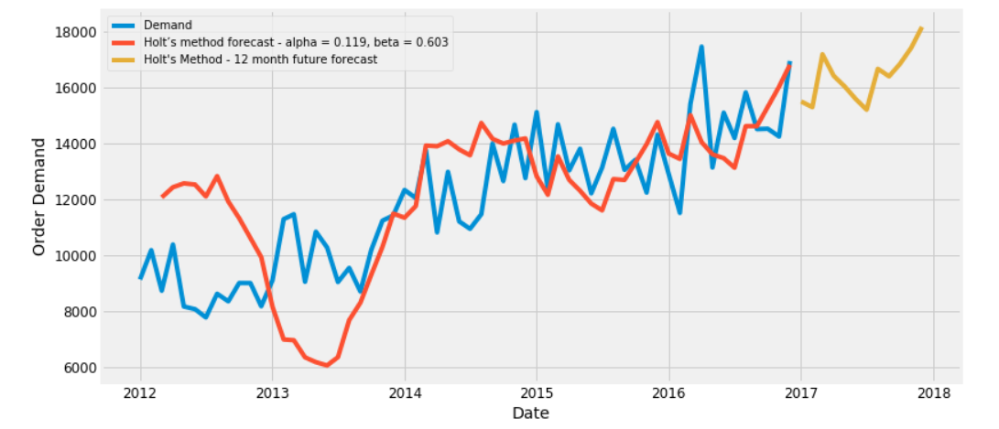
Validating Holt’s Method Forecasted Data
The Mean Square Error 2126606.64
The Root Mean Squared Error is 1458.29
The Mean Absolute Percentage error is 8.03

Slide 12
Visualizing Future Forecasts using Holt’s Method

Slide 13
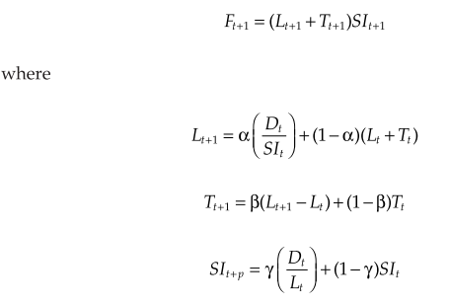
Holt-Winters Seasonal Method
Holt-Winter’s method is an extension of the Holt’s method by updating seasonality indices also using exponential smoothing.
Given the actual demand D_{t}, the estimates of level (L_{t}), Trend (T_{t}) and seasonality indices SI₁, SI₂, …, SI_{t+p−1}, the forecast for the perio (t+1) is given by
F_{t+k} = (L_{t}+kT_{t})S_{t-m+k}
Where L_{t} = α(D_{t}
Where α, β and ϒ are smoothing agents for Level, Trend and Seasonality resp. and they lie between 0 and 1

Slide 14
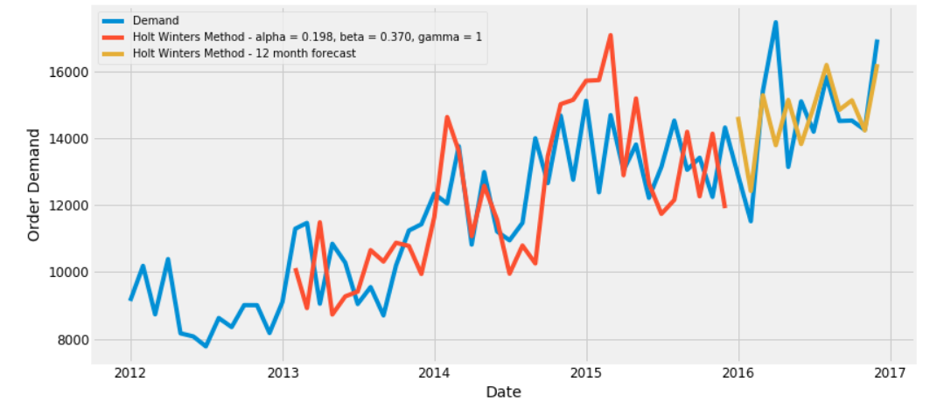
Validating Holt Winter’s Forecasted Data
The Mean Squared Error is 2059888.06
The Root Mean Squared Error is 1435.23
The Mean Absolute Percentage Error is 7.11%

Slide 15
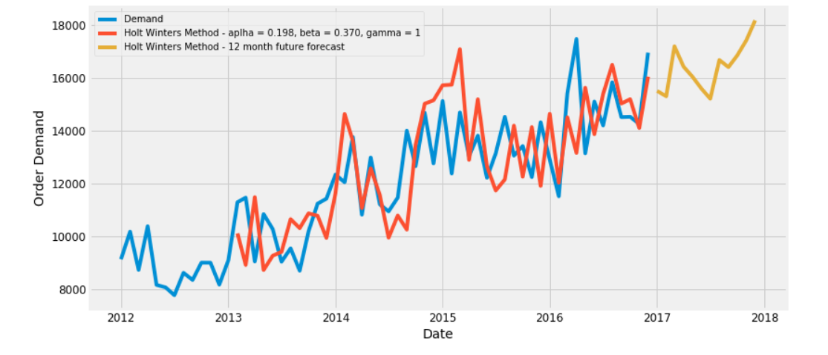
Visualizing Forecasts using Winter Holt’s Method

Slide 16
SARIMA Model
Seasonal Autoregressive Integrated Moving Average or Seasonal ARIMA is a forecasting method for univariate(single changing variable)time series data.
TREND Elements
p: Trend autoregression order.
d: Trend difference order.
q: Trend moving average order
SEASONAL Elements
P: Seasonal autoregressive order.
D: Seasonal difference order.
Q: Seasonal moving average order.
m: The number of time steps for a single seasonal period.
SARIMA(p,d,q)(P,D,Q)m

Slide 17
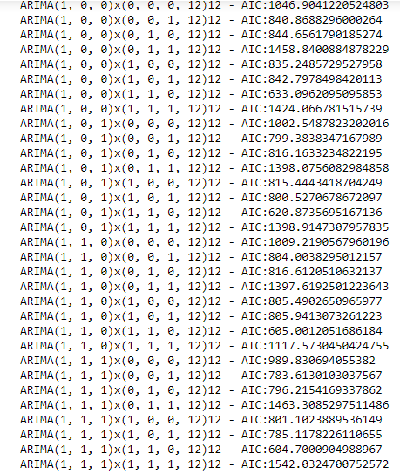
Parameter selection for the ARIMA Time series model
The Augmented Dickey Fuller (AFD) Test helps us determine the stationarity of the series.
The Akaike Information Criterion (AIC) values are computed in Python using “statsmodels”. The AIC determines the extent to which features were used to fit the model to the data. Thus, a lower AIC is preferred to train the SARIMA model.
Thus, lowest AIC= 604.70009, giving us the SARIMAX(1,1,1)x(1,1,0,12) as the optimal option.

Slide 18
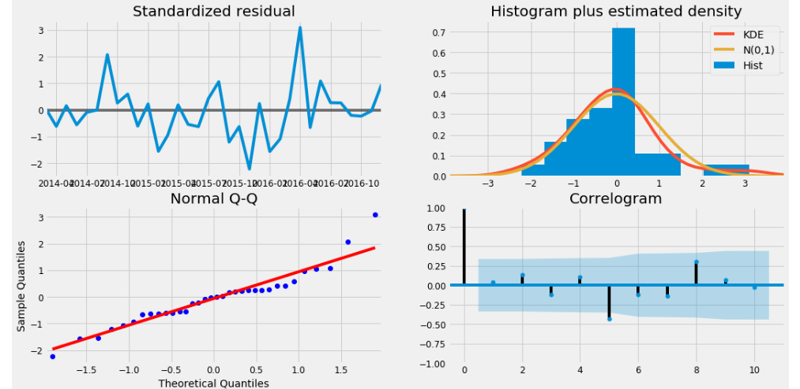
SARIMA Model Diagnostics

Slide 19
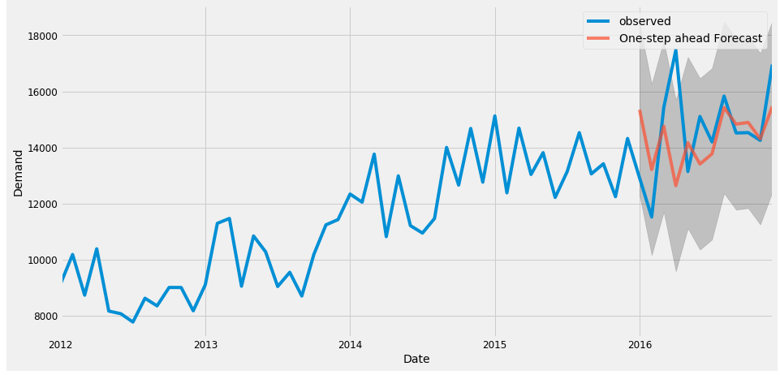
Validating SARIMA Model Forecast
The Mean Squared Error is 3277197.12
The Root Mean Squared Error is 1810.3
The Mean Absolute Percentage Error is 8.67%

Slide 20
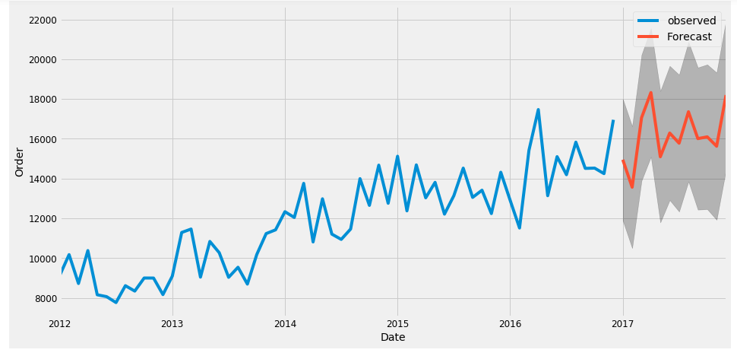
Visualizing Forecasts using SARIMA Model

Slide 21
Forecast Accuracy Measure
Forecasting Models | Root Mean Square Error (Count) | Mean Absolute Percentage Error (%)
Exponential Smoothing Model | 1894.09 | 10.09
Holt’s Method using Static Seasonality Indices | 1458.29 | 8.03
Holt-Winter’s Seasonal Method | 1435.23 | 7.11
Seasonal Autoregressive Integrated Moving Average (SARIMA) | 1810.3 | 8.67

Slide 22
Conclusion
Thus, we have compared the forecasting ability of Holt-Winters and SARIMA models by comparing the MRSE and MAPE values
Although the value of errors for both the models are pretty close, we can conclude that Holt-Winters forecasting model is the best fit for our data due to its relative ease of use and lower error values.

Slide 23

THANK YOU

